Slide 1

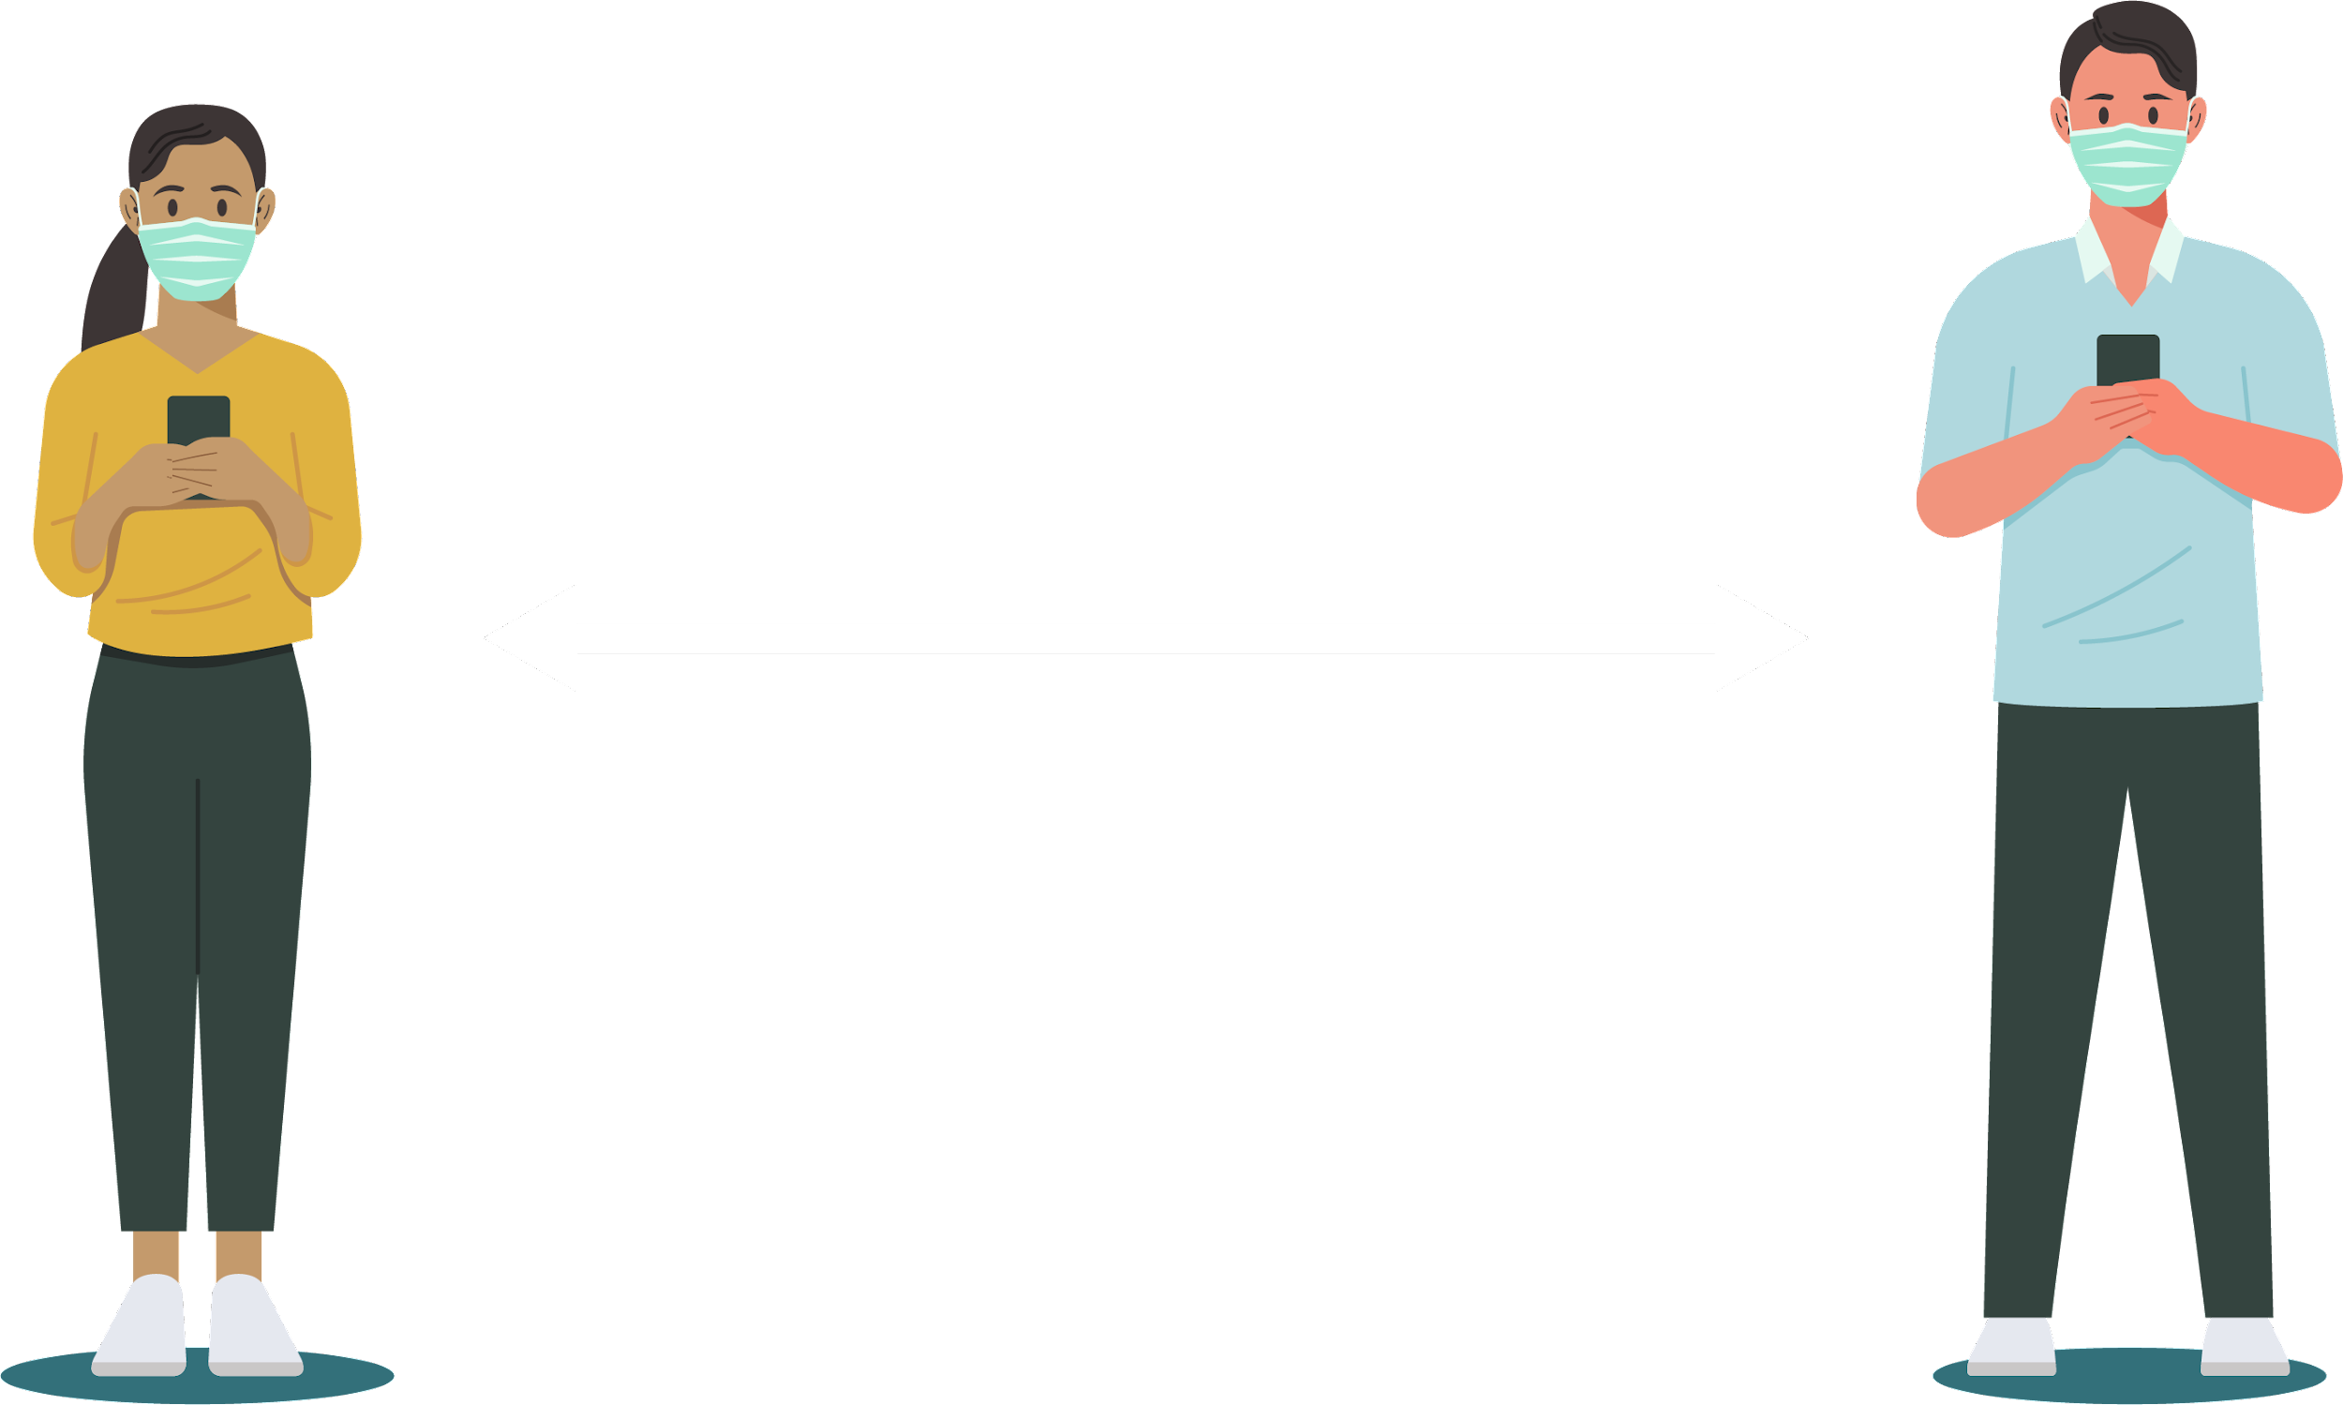
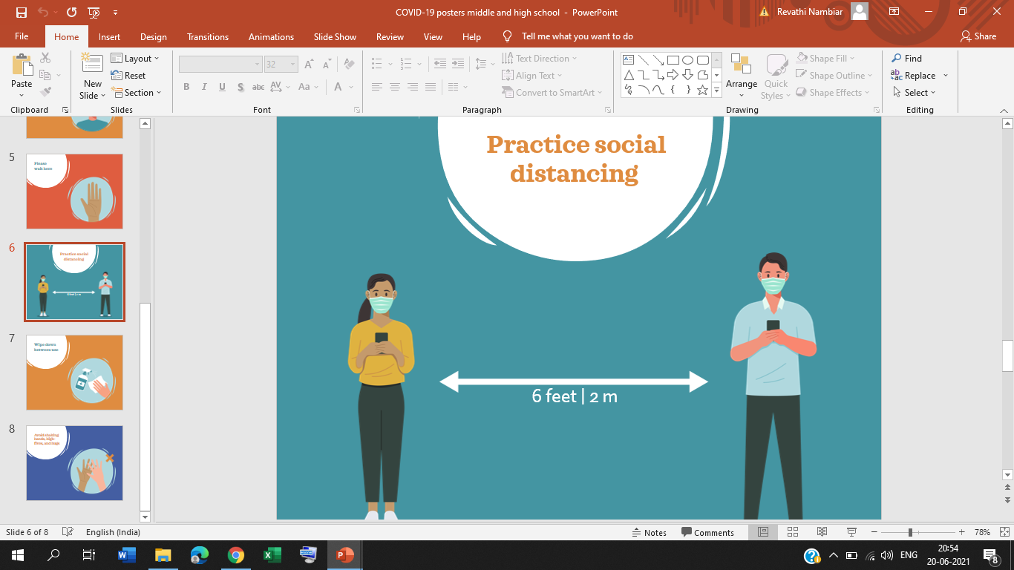

19DS799: Major Project Repurposing Existing Drugs for Treatment of Covid-19
Presented by- Under the Guidance of-
Revathi S Nambiar Dr. Deepa Gupta
BL.EN.P2DSC19010 Associate Professor, CSE
ASE, Bengaluru.

Slide 2
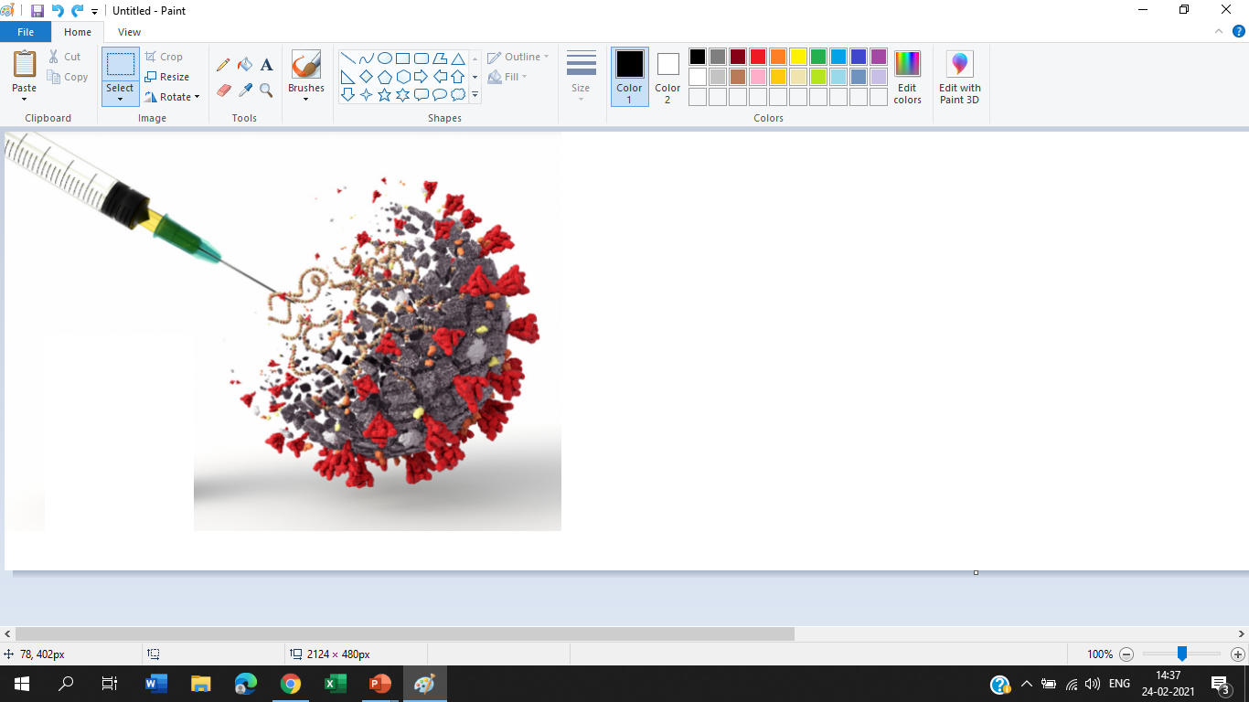
INTRODUCTION
Since the identification of the SARS-CoV-2 virus and its genome, an exceptional effort by the scientific community has led to the development of over 300 vaccine projects.
Over 40 are now undergoing clinical evaluation, some of these are in Phase III clinical trials, some of them have ended Phase III with positive results. A few of these new vaccines are already approved for emergency use.
Drug development is a time-consuming, expensive and high-risk process and this has led to the emergence of drug repurposing (also known as drug repositioning or drug re-profiling),.
Moreover, it remains to be elucidated whether and to what extent the capacity of vaccines under evaluation and of unrelated vaccines can increase immunological fitness by training innate immunity to SARS-CoV-2 and pathogen-agnostic protection.

Slide 3

INTRODUCTION
Due to the short development time and the novelty of the technologies adopted, these vaccines will be deployed with several unresolved issues that only the passage of time will permit to clarify.
Technical problems connected with the production of billions of doses and ethical ones connected with the availably of these vaccines also in the poorest countries, are imminent challenges facing us.
It is our tenet that in the long run more than one vaccine will be needed to ensure equitable global access, protection of diverse subjects and immunity against viral variants.
A well-known example is that of aspirin, which was originally used for pain relief and has since been used to prevent cardiovascular disease and cancer

Slide 4

MOTIVATION
Drug repositioning is a highly active field of biomedical research and is paralleling vaccine research and development in the fight against COVID-19.
Drug repurposing is a huge industry and has a promising future as it is one of the most active areas in pharmacology in the last decade.
Drugs are constantly being tested in order to be used for new purposes, of which they were not originally intended.
It may allow for more systematic and substantially less expensive methods in the discovery of new treatments for diseases when compared to traditional drug development.
These repurposed drugs have demonstrated that drug repurposing is a promising way to improve drug discovery

Slide 5

OBJECTIVE
To find the potential of repurposing the drugs, using the covid-19 articles in order to make it easy for the researchers.
Sentiment analysis is required , Features of sentiment analysis can be helpful in detecting adverse drug reactions within the text .
To capture the sentiments of Top Drug Names with positive notation for Covid-19 treatments.
Find most relevant drug names within the articles related to covid-19 treatment.

Slide 6
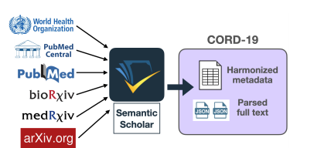
DATASET
CORD-19 aims to connect the machine learning community with biomedical domain experts and policy makers in the race to identify effective treatments and management policies for COVID19.
Papers in CORD-19 are sourced from PubMed Central (PMC), PubMed, the World Health Organization’s Covid-19 Database,4 and preprint servers bioRxiv, medRxiv, and arXiv

Slide 7
PROBLEM STATEMENT
Repositioning or Repurposing of Existing Drugs (which was intended to serve other medical problems) for Treatment of Covid-19 using various Articles published by utilizing various NLP sentiment analysis methods.

Slide 8
LITERATURE SURVEY
TITLE | METHODOLOGY | FINDINGS | JOURNAL/CONFERENCE
Literature-based discovery of new candidates for drug repurposing(for different cancers) | Pattern-based relationship extraction method to extract disease–gene and gene–drug direct relationships from the literature, Drug vector space model. | Repurposed drug candidates for the treatment of various cancers, new indications was comprehensively integrated and summarized by a single plot, i.e. chord diagram, which was first used to demonstrate the wheel of drug repurposing | IEEE International Conference on Bioinformatics and Biomedicine (2018)
A Systematic Framework for Drug Repurposing based on Literature Mining | Logistic regression model to predict how effectively the drug counteracts the disease based on the generated disease/drug vectors. Two vectors to describe clinical disease symptoms and clinical drug effects.. | Analogical reasoning approach based on the ABC model and proposed a systematic framework for discovering hidden disease–drug associations. | IEEE International Conference on Bioinformatics and Biomedicine (2019)

Slide 9
LITERATURE SURVEY
TITLE | METHODOLOGY | FINDINGS | JOURNAL/CONFERENCE
Detecting Serendipitous Drug Usage in Social Media with Deep Neural Network Models | Convolutional neural network (CNN), long short-term memory network (LSTM), and convolutional long short-term memory network (CLSTM) | Detection of serendipitous drug usage in social media as a binary classification problem and investigated deep neural network models as a solution from drug-review posts | IEEE International Conference (2020)
Deep Learning for Predicting Drug-Target Interactions: A Case Study of COVID-19 Drug Repurposing | Heterogeneous graph attention (HGAT) model to learn topological information of compound molecule. (SMILES) Simplified Molecular Input Line Entry System representation of input compounds is learned through bidirectional ConvLSTM architecture. | Framework for predicting DT(drug target) binding affinity using target protein sequences | The Lancet Digital Health journal (2019)

Slide 10
LITERATURE SURVEY
TITLE | METHODOLOGY | FINDINGS | JOURNAL/CONFERENCE
An Analytical Review of Computational Drug Repurposing | Link prediction, community detection , graph based learning, literature based learning | Literature-based models - These methods rely on the processing of publicly accessible biomedical literature data to uncover indirect or innate relationships among seemingly unconnected biological entities. | IEEE International Conference (2020)
Semi-supervised graph cut algorithm for drug repositioning by integrating drug, disease and genomic associations | Drug-disease pair graph with drug disease pairs as nodes, and the similarity between two pairs denotes the weight of the edge between two nodes, used their similarity measures. | SSGC, to integrate three layers(treatment, gene ,base) of information with the purpose of predicting new drug-disease treatment relations | IEEE International Conference on Bioinformatics and Biomedicine (2019)

Slide 11
LITERATURE SURVEY
TITLE | FINDINGS | JOURNAL/CONFERENCE
Artificial intelligence in COVID-19 drug repurposing | FNN to classify drugs into pharmaceutical therapeutic classes based on the drugs | The Lancet Digital Health journal (2020)
Characterization of potential drug treatments for COVID-19 using social media data | Using sentiment analysis and stance detection, we can also identify how users respond to these drugs and identify the drugs that help with some symptoms | ACL Workshop 2020

Slide 12
SUMMARY OF LITERATURE SURVEY
Most of the work carried out focused on repurposing drugs for curing cancer or different types of cancers or on a generalized .
Previous work reported used the reviews and posts or drug review post about drugs from social media.
Work carried out mainly used pattern-based relationship extraction method to extract disease–gene and gene–drug relationship.
Graph based techniques using ABC model for protein sequences and genomic sequences where used.

Slide 13
RESEARCH GAPS AND CHALLENGES
Techniques used was tedious in terms of identifying the sequences of genes and protein, and also the output required expert analysis.
Most of the work so far reported where on analysis of drug post reviews, tweets and not on articles or literature of covid-19.
Pretrained drug dataset on articles is not available instead reviews and tweets dataset about drugs are available .
Previously reported work so far focused only on the sentiment of one drug at a time and also used primitive drug source information.

Slide 14



PROPOSED SYSTEM ARCHITECTURE
Filtering and Formatting of covid-19 articles
File analysis of PDF and PMC files
Drug names filtering using RxNav
NLP sentiment analysis
Extract sentences relating to covid-19 and drug names
Top-n repurposed drug names

Slide 15
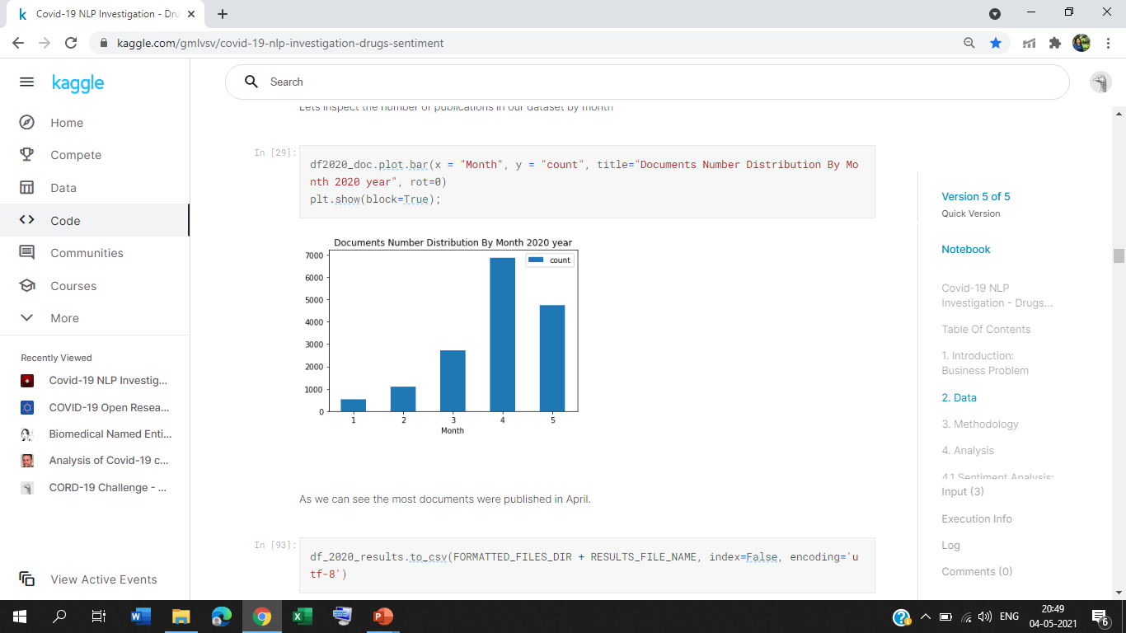
PRE-PROCESSING
The dataset was large and contained literatures/articles other than covid-19 thus required filtering and formatting of the articles.
Filtered articles which belonged to 2020 year only and having file links – pdf json files or pmc json files.
Cord-19 documents filtered by publication date equal 2020 year.
Analysis of the articles indicated that most of them where published in the month of April.

Slide 16
PRE-PROCESSING
Extracted Drugs' names from RxNav which contained 18176 unique entries .
RxNav is a browser for several drug information sources, including RxNorm and RxTerms.
RxNav finds drugs in RxNorm from the names and codes in its constituent vocabularies.

Slide 17
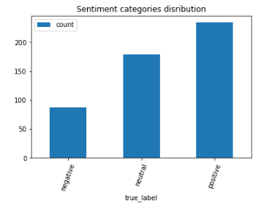
METHODOLOGY
The sentences with covid-19 and Drugs names with distance of 2 sentences from each other are extracted and then statistics about drugs names distribution in each document is calculated.
Then use the NLP sentiment analysis model, problem here is that all existing sentiment models are pre-trained on social media datasets (tweets, movie/hotels reviews).
Manually labelled dataset included following sentiments category
distribution.

Slide 18
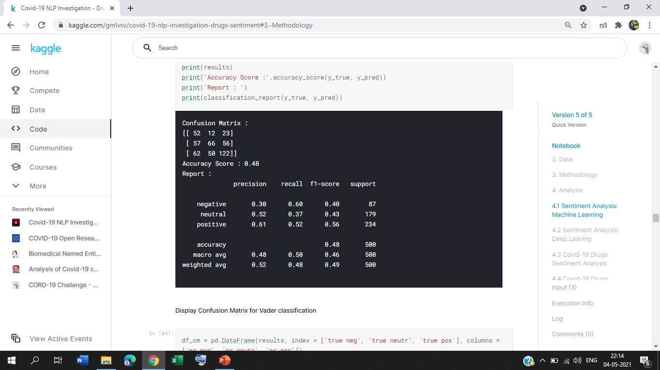
VADER SENTIMENT ANALYSIS
VADER (Valence Aware Dictionary and sentiment Reasoner) is a lexicon and rule-based sentiment analysis tool that is specifically attuned to sentiments .
Vader is optimized for social media data and can yield good results when used with data from Twitter, Facebook, etc. Released on may 22, 2020.

Slide 19
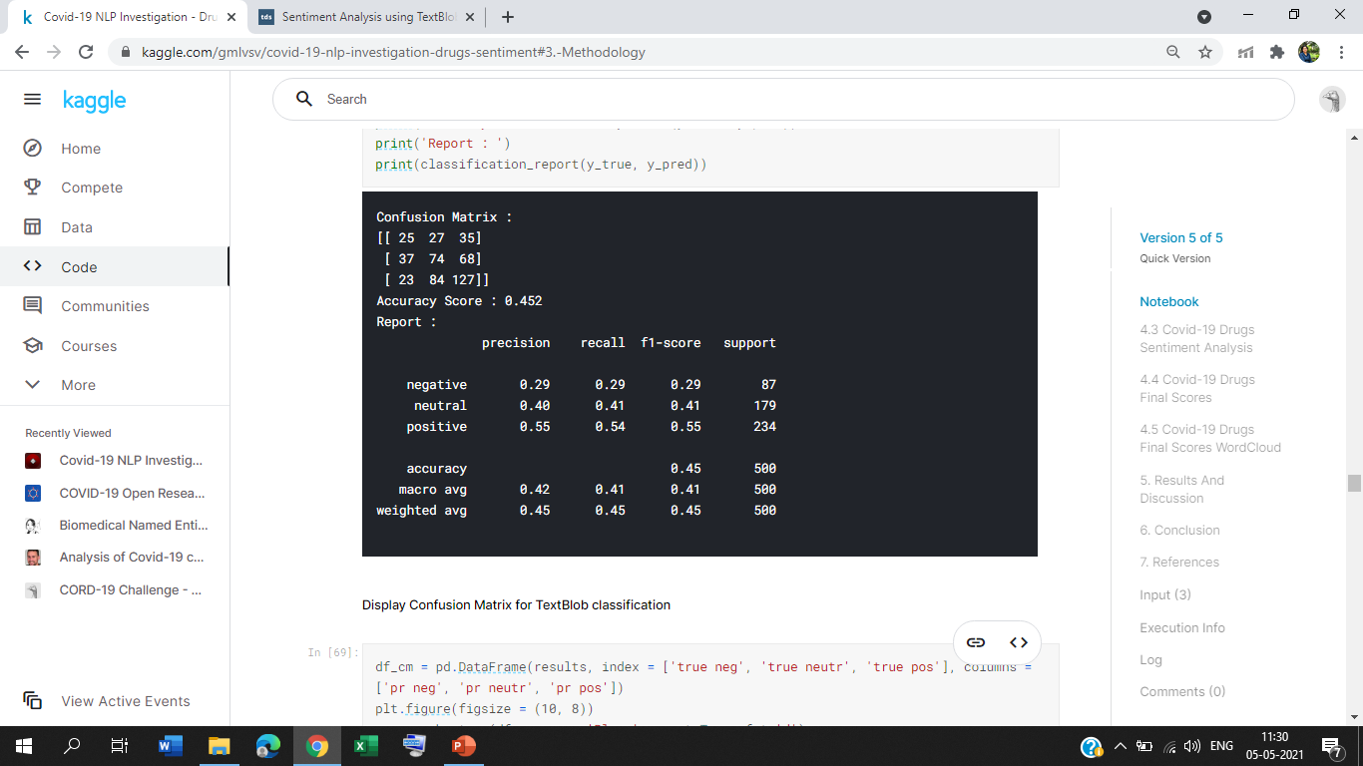
TEXT BLOB SENTIMENT ANALYSIS
Text Blob uses a sentiment lexicon (consisting of predefined words) to assign scores for each word, which are then averaged out using a weighted average to give an overall sentence sentiment score.
Three scores: “polarity”, “subjectivity” and “intensity” are calculated for each word. We are interested only in “polarity": negative vs. positive (-1.0 => +1.0)

Slide 20
DEEP LEARNING SENTIMENT ANALYSIS
Deep learning does not necessitate the manual tuning of features based on expert knowledge and available linguistic resources.
Textual data has to be converted into numeric form before it can be used by deep learning models, One way to convert text to numbers is via word embeddings.
Word embeddings are learned from data and essentially are low dimensional floating point vectors that pack information in few dimensions

Slide 21
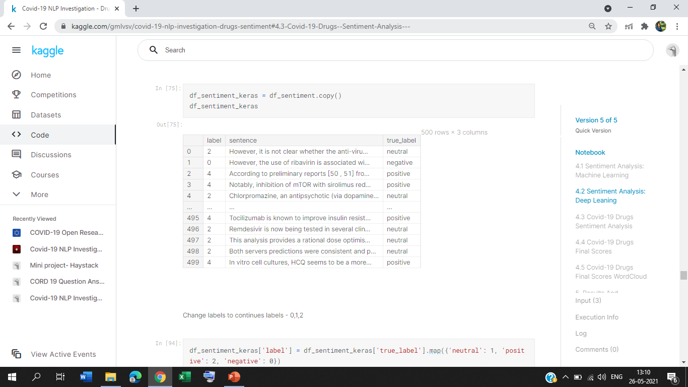
DEEP LEARNING SENTIMENT ANALYSIS
Change labels to continues labels ( emotions) to - 0,1,2.
Created a model with one input layer (embedding layer), one LSTM layer with 128 neurons and one dense layer that will act as the output layer as well.
Deep learning models converge easier with dense vectors than with sparse ones.

Slide 22
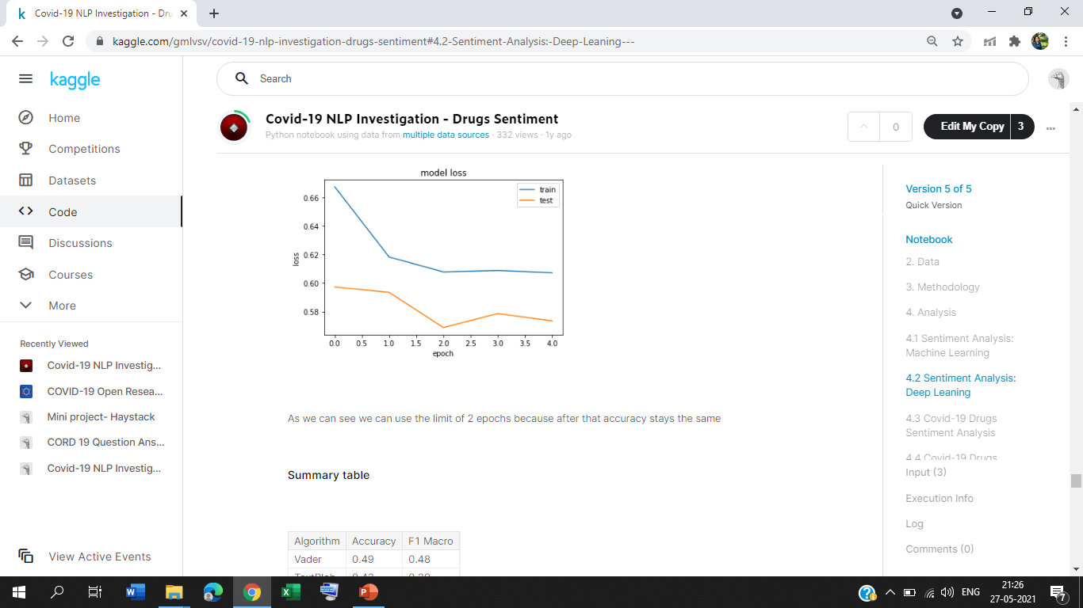
DEEP LEARNING SENTIMENT ANALYSIS
We can limit the number of epochs to two because after that accuracy stays the same.

Slide 23
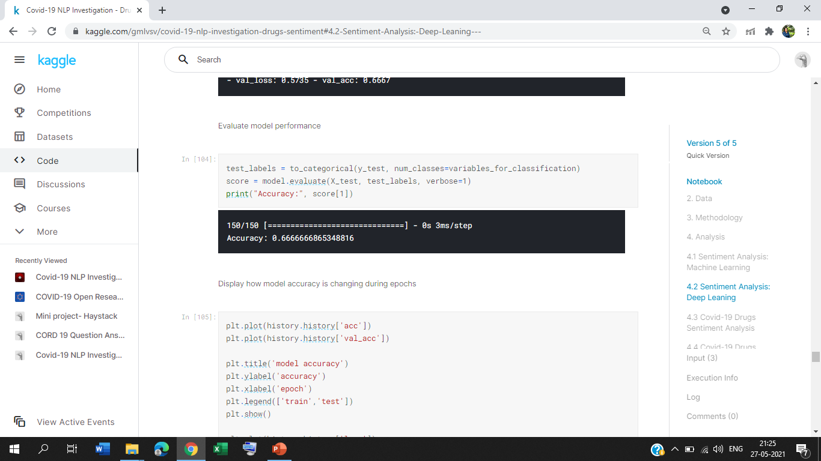
DEEP LEARNING SENTIMENT ANALYSIS
Since there are 3 possible outputs, the number of neurons will be 3 and the activation function will be SoftMax.
Categorical_crossentropy was used as loss function and adam as the optimization function.

Slide 24
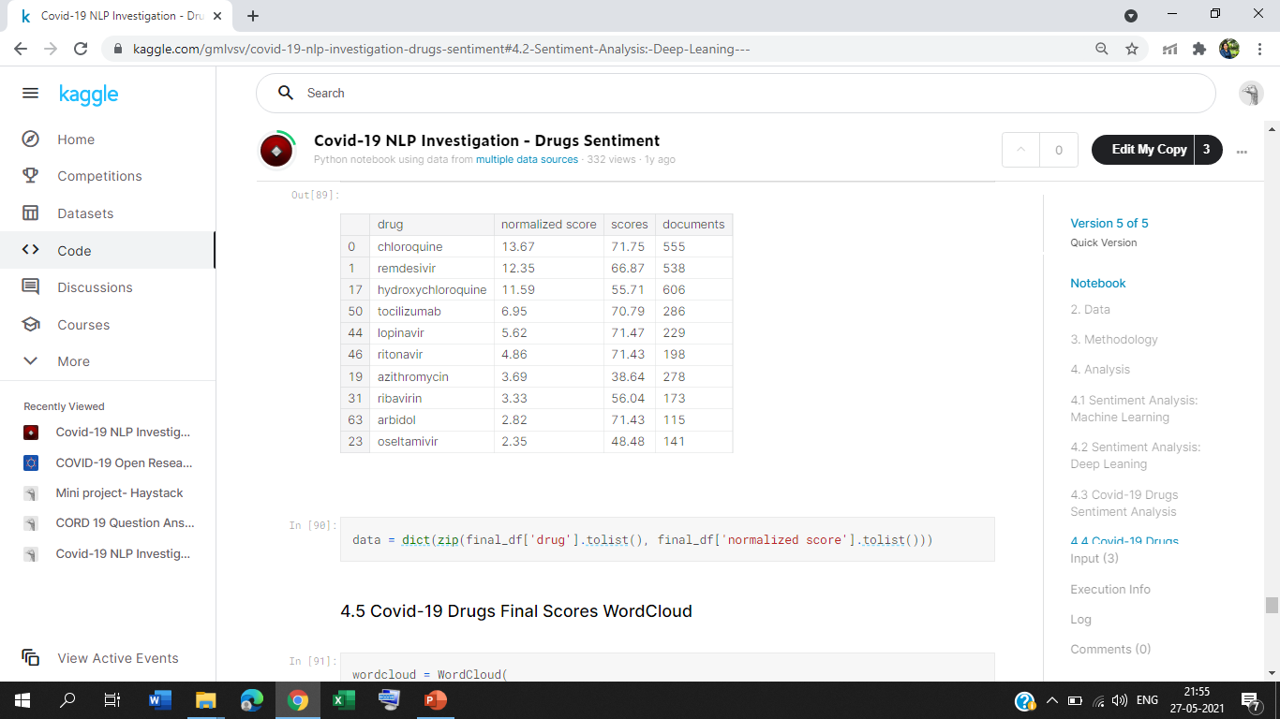
NORMALIZED DRUG SCORES
Normalized sentiment score : (Average Score) * (Number of Document with drug mentioned / Total Number of Documents)

Slide 25
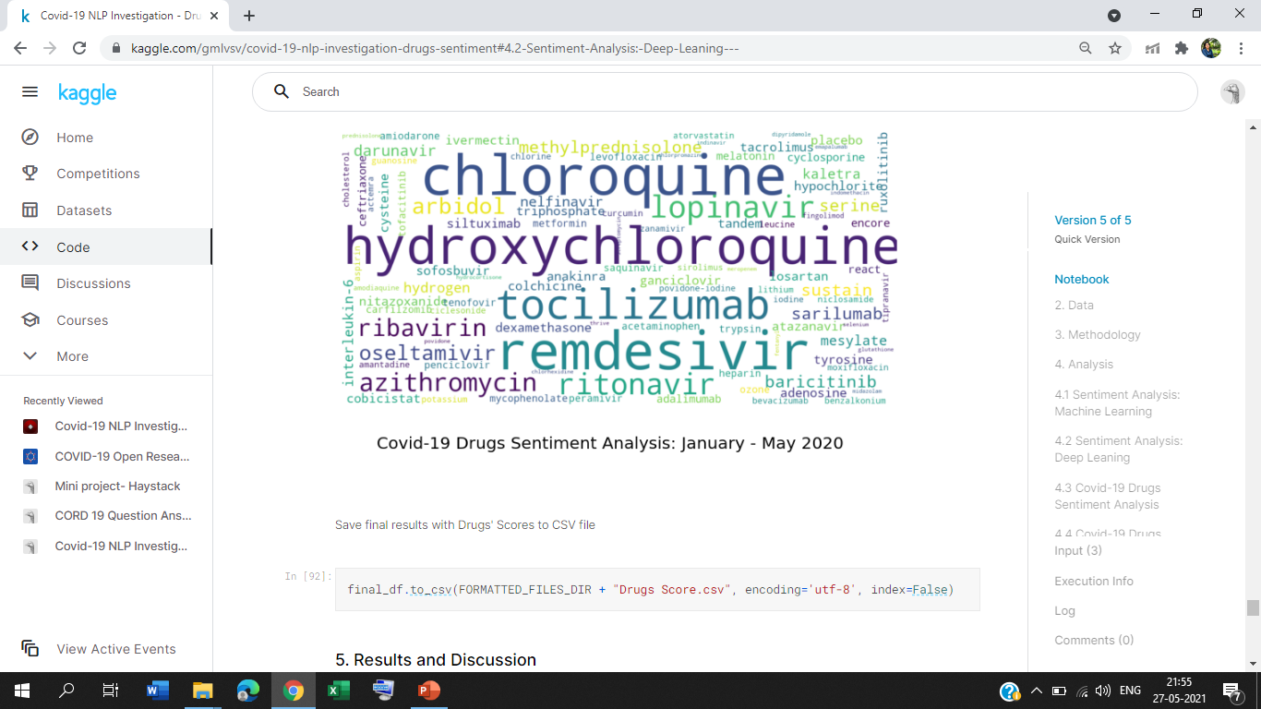
RESULTS AND DISCUSSIONS
The Top-3 Drugs with the highest positive sentiments normalized scores were found with accuracy of 65%:
Chloroquine with score 13.67 extracted from 555 documents (total, with any sentiments)
Remdesivir with score 12.35 extracted from 538 documents (total, with any sentiments)
Hydroxychloroquine with score 11.59 extracted from 606 documents (total, with any sentiments)

Slide 26
RESULTS AND DISCUSSIONS
Remdesivir is currently the only medication approved by the FDA to treat coronavirus disease 2019 (COVID-19). Remdesivir is also being studied in combination with other medications.
Several hydroxychloroquine studies gained a lot of attention in media reports, especially in the early months of the pandemic.
In vitro studies (studies done in a petri dish or test tube rather than in animals or humans). Hydroxychloroquine and chloroquine have antiviral properties against SARS-CoV-2, the virus that causes COVID-19.
In these studies, these medications worked by interfering with the chemical environment of human cell membranes. This blocked the virus from entering and multiplying inside the cells. A medication working in vitro does not always mean that it will work once inside a human body.

Slide 27
RESULTS AND DISCUSSIONS
Based on these in vitro findings, researchers rushed to study the effects of hydroxychloroquine and chloroquine in hospitalized patients with COVID-19. Early results were shared with the media, which led hospitals worldwide to start using these medications.
In hospitalized patients with Covid-19 pneumonia who were not receiving mechanical ventilation, tocilizumab reduced the likelihood of progression to the composite outcome of mechanical ventilation or death, but it did not improve survival.

Slide 28
RESULTS AND DISCUSSIONS
Cocktail drugs- One research group looked at azithromycin in combination with hydroxychloroquine for COVID-19. They reported that 93% of patients cleared the virus after 8 days, but there was no control group so we don’t know if people would have cleared the virus on their own without the medications.
The therapy is said to reduce the chance of hospitalisation by 70 per cent in patients with mild to moderate Covid-19 symptoms.
Patients who received combination treatment with baricitinib plus remdesivir recovered a median of 1 day faster than patients who received remdesivir alone.

Slide 29
CHALLENGES FACED
Medical Domain is extremely complex - it's not quite clear for a human without medical education to understand some sentence's sentiment;
I have not found any labelled datasets for the Sentiments analysis in Medical Domain. Existing pre-trained models based on the data from social media (tweets, movies/hotels reviews) and do not fit for medical documents.
NTLK sentence parser is not very good for this medical corpus documents.
Drugs names were limited to the RxNav Rest API results.

Slide 30
CONCLUSION
To conclude, the basic document analysis was performed to identify Top Drugs Names which have positive sentiments related Covid-19 treatment.
The aim of this project is to find the Drugs Names which likely help against COVID-19 based on positive characteristics stated about the particular drug in the Medical Documents extracted from the different sources like PubMed, WHO, and others.
This project also finds ways to help researchers to develop combinational drugs to reduce the severity in patients infected with covid-19.

Slide 31
FUTURE WORK
Add a weight to the score depending on the section's name or parse Drugs Names from the special document's sections alone to find the combinational drug.
Improve the splitting and detection of sentences.
At the very least, find or develop Labelled Sentiment datasets for Medical Domain linked to combinational Drugs Treatment.

Slide 32
REFERENCES
1. Oscar Araque ,Kyriaki Kalimeri, Lorenzo Guti "Sentiment and Moral Narratives during COVID-19 ”, ACL 2020 Workshop NLP-COVID Submission.
2. Ramya Tekumalla Juan M Banda, “Characterization of Potential Drug Treatments for COVID-19 using Social Media Data and Machine Learning “, arXiv preprint arXiv:1903.10676.
3. Hyeju Jang, Emily Rempel, Giuseppe Carenini1 , Naveed Janjua, ” Exploratory Analysis of COVID-19 Related Tweets in North America to Inform Public Health Institutes”, Bioinformatics 36, no. 4 (2020): 1234-1240.
4. Anna Kruspe ,Matthias Haberle ,” Cross-language sentiment analysis of European Twitter messages during the COVID-19 pandemic”, ACL 2020 Workshop NLP-COVID Submission.

Slide 33
REFERENCES
5. Hsih-Te Yang, Jiun-Huang Ju, “Literature-based discovery of new candidates for drug repurposing”, Briefings in Bioinformatics 2018.
6. Gaocai Dong, Ping Zhang, Jingya Yang, Dongdong Zhang, Jing Peng, “A Systematic Framework for Drug Repurposing based on Literature Mining” IEEE International Conference on Bioinformatics and Biomedicine 2019.
7. Mohamed Abdel Basset , Hossam Hawash Mohamed Elhoseny, Ripon K. Chakrabortty and Michael Ryan “DeepH-DTA: Deep Learning for Predicting Drug-Target Interactions: A Case Study of COVID-19 Drug Repurposing”, IEEE International Conference 2020.
8. Boshu Ru, Dingcheng Li, Lixia Yao, “Detecting Serendipitous Drug Usage in Social Media with Deep Neural Network Models”, IEEE International Conference on Bioinformatics and Biomedicine 2018.

Slide 34
REFERENCES
9. Seyedeh Shaghayegh Sadeghi , Mohammad Reza Keyvanpour, “An Analytical Review of Computational Drug Repurposing”, IEEE International Conference 2020.
10. Guangsheng Wu, Juan Liu , Caihua Wang, “Semi-supervised graph cut algorithm for drug repositioning by integrating drug, disease and genomic associations”, IEEE International Conference on Bioinformatics and Biomedicine 2018.
11. Yadi Zhou, Fei Wang, Jian Tang, Ruth Nussinov ,Feixiong Cheng, “FNN to classify drugs into pharmaceutical therapeutic classes based on the drugs”, The Lancet Digital Health journal 2020.

Slide 35
THANK
YOU

